Slide 1
Guided Capstone
Big Mountain Resort

Slide 2
How can Big Mountain Ski Resort increase revenue for the coming season?
Ticket Prices
Is there room to increase ticket price?
Facility Management
What changes/removals/additions can cut cost and/or increase value?

Slide 3
Findings
Big Mountain’s ticket price is currently LOW based on the Resort’s features
A slightly higher ticket price should generate more revenue without decreasing visitors
There are a couple facility adjustments that can be made to further increase revenue, as well

Slide 4
Current Ticket Price = $81
Based on current features, our model estimates Big Mountain’s market ticket value to be around $96.
Most Valuable Resort Features
# of Fast Quads
# of Overall Runs
Vertical Drop & Snow making area
Big Mountain ranks amongst the top 5-10% nationally in ALL of the key feature areas

Slide 5
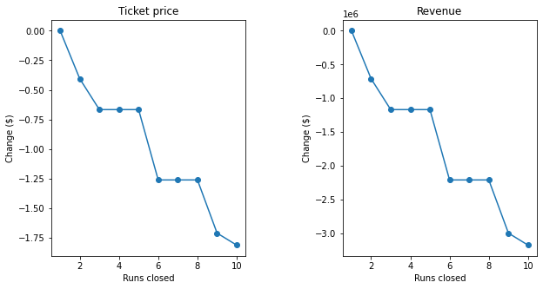
Facility Adjustment Scenarios
Closing one run has no effect at all on ticket value and revenue
Closing 5 runs reduces value no more than closing 3.

Slide 6
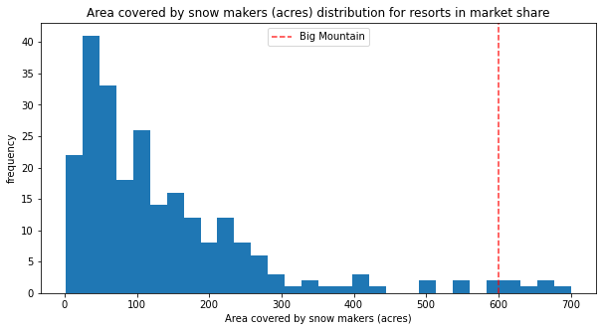
Scenarios
Adding a run to extend vertical drop results in ticket value increase of $1.99
Potential revenue ($3.5M) > cost of extra chair lift
Adding acreage covered by snowmakers would be unlikely to increase revenue at all
Big Mountain already has
More coverage than 95%
Of resorts

Slide 7
Final Recommendations
Increase Ticket Price by $4 - $8
Eliminate the least used Run
For more aggressive cost cutting, remove exactly 4 more
Extend vertical drop by adding one more run below the current lowest run

